Slide 1
Computer Organization and Assembly Fall 2019
Lecture 10 &11
Syeda Farwa Batool

Slide 2
Note :
IP points to the instruction which has to execute next, but in these slides IP arrow will point to executed instruction [only for these slides ] .

Slide 3
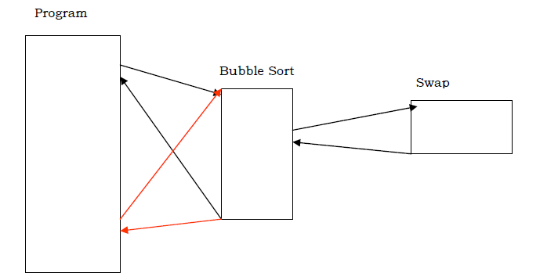
Subroutines

Slide 4
Call
Call
This instruction save the next value of IP on stack.
And change the current value of IP with offset, that is given with call instruction
Ret
Retrieve the value of IP from stack.
For Example
IP
mov ax ,10 call myFun mov bx, 5 …………… …………… | myFun: ………………….. …………………… ret
IP
IP
IP
IP
IP

Slide 5
Stack
Stack is a data structure that behaves in a first in last out manner. It can contain many elements and there is only one way in and out of the container.
When an element is inserted it sits on top of all other elements and when an element is removed the one sitting at top of all others is removed first.
We have SS segment to save values at stack, and a stack pointer which tells the position of currently inserted element. For example in above case SP will point at 5.
SP
5
6
8
7
10

Slide 6
Push and Pop
Push
It save a value on the top of stack.
For Example
push ax ; it save ax value on stack
SP <-- SP – 2 ;;; Making space in stack to save value
[SP] <-- AX ;;saving value
Pop
It deletes the top element from stack
AX <--- [SP] ;;; Retrieving top value of stack
SP <-- SP + 2 ;;Removing space of that top element

Slide 7
Save register Values in subroutine
Push registers on stack, before using them.
jmp start myFun: push ax pusb bx mov ax,15 ;;ax = F mov bx,8 ;; bx = 8 pop bx pop ax ret start: mov ax,10 ;; ax = 10 mov bx, 9 ;; bx = 9 call myFun …………… ;; value of ax = 10 and bx = 9 after function
Stack
IP
IP
IP
IP
SP
9
Deleted from stack
IP
IP
SP
10
Deleted from stack
IP
Returning address (IP)
SP
Deleted from stack
IP
SP
IP
IP

Slide 8
Use BP to differentiate Activation records
jmp start myFun: push ax pusb bx mov ax,15 ;;ax = F mov bx,8 ;; bx = 8 pop bx pop ax ret start: mov ax,10 ;; ax = 10 mov bx, 9 ;; bx = 9 call myFun
push bp ;;;;;;;;;;;; save previous value of bp
mov bp,sp ;;;;;;;;;;;; now all values on stack after bp are part of ;;;;;;;;;;;;;;;;;myFunction
Stack
These are MyFun variables
SP
9
10
Value of BP
BP
Returning address (IP)
These are start
variables

Slide 9
Returning Value from a subroutine
jmp start myFun: push bp mov bp,sp push ax pusb bx mov ax,15 ;;ax = F mov bx,8 ;; bx = 8 mov [bp + 4], ax pop bx pop ax pop bp ret start: mov ax,10 ;; ax = 10 mov bx, 9 ;; bx = 9 push 0 call myFun pop dx ;;; pop function return value in dx [can be any reg or memory]
IP
Stack
IP
IP
IP
Deleted from stack
SP
9
IP
Deleted from stack
IP
SP
10
IP
IP
Value of BP
BP
SP
Deleted from stack
IP
Returning address (IP)
IP
SP
Deleted from stack
IP
SP
0
15
Place is created to save returning value of function
IP
SP
IP
IP
IP
IP

Slide 10
Parameter Passing To a subroutine
jmp start myFun: push bp mov bp,sp push ax pusb bx mov ax,[bp + 4] ;;ax = 20 mov bx, [bp + 6] ;; bx = 30 add ax,bx mov [bp + 4], ax pop bx pop ax pop bp ret 4 start: mov ax,10 ;; ax = 10 mov bx, 9 ;; bx = 9 push 0 push 20 ;; save 1st parameter push 30 ;; save 2nd parameter call myFun pop dx ;;; pop function return value in dx [can be any reg or memory]
IP
IP
Stack
IP
IP
IP
IP
SP
9
Deleted from stack
IP
Deleted from stack
IP
SP
10
IP
Value of BP
BP
IP
SP
Deleted from stack
IP
Returning address (IP)
Deleted from stack
IP
SP
SP
30
IP
IP
SP
20
IP
Place is created to save returning value of function
IP
SP
0
15
IP
SP
IP
IP

Slide 11
Local Variables in Subroutine
jmp start myFun: push bp mov bp,sp sub sp, 2 ;; space for local variable sub sp, 2 ;; space for local variable mov [bp - 2] , 10 ;; use local var mov [bp - 4], 20 mov sp, bp pop bp ret start: mov ax,10 ;; ax = 10 mov bx, 9 ;; bx = 9 call myFun ;;exit code
IP
IP
Stack
IP
IP
IP
SP
20
Deleted from stack
IP
SP
10
Deleted from stack
IP
IP
Value of BP
BP
IP
SP
Deleted from stack
Returning address (IP)
Deleted from stack
IP
SP
IP
SP
IP
IP
Place is created to save returning value of function

Slide 12
MUL
Mul
For Unsigned number
The Carry flag indicates whether or not the upper half of the product contains significant digits.
val1 WORD 2000h
val2 WORD 100h
.code
mov ax, [val1]
mov bx , [val2]
mul bx ; DX:AX = 00200000h, CF=1

Slide 13
DIV
Div
Reminder is in DX
mov dx,0 ; clear dividend, high
mov ax, 8003h ; dividend, low
mov cx, 100h ; divisor
div cx
; AX = 0080h, DX = 3

Slide 14
Class Participation
Question # 1
Write a subroutine which generate prime numbers you have to pass an integer and address of an array to that subroutine. The integer indicates the numbers of primes you want to generate from subroutine and then put your prime numbers at given address of array.

